Slide 1
Run 8650 Efficiency Results
Tanvi Krishnan
Mentor: Gianluca Petrillo

Slide 2
Run 8650 Details
Run 8650 and 7232 are both minimum bias runs
PMT readout window is (-69 µs, 117 µs) – wider than the previous (-75µs, 75µs)
Run statistics (number of tracks) are as follows:
We do not use the reconstructed flashes for the trigger efficiency analysis
Trigger emulation window selection: (-15µs, 5µs) in the West cryostat and (-20µs, 0µs) in the East cryostat
 | East Cryostat | West Cryostat
Run 7232 | 12561 | 16233
Run 8650 | 16203 | 19826

Slide 3
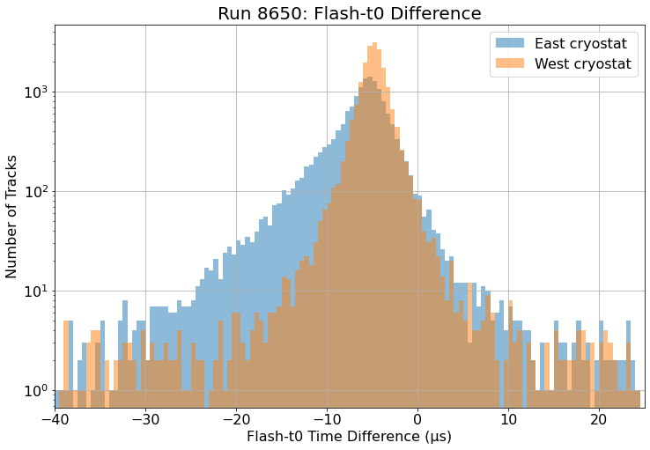
Trigger Emulation Windows
Selected the blue emulation window (-15µs, 5µs) for the East cryostat and the orange emulation window (-20µs, 0µs) for the West cryostat

Slide 4
Run 8650 – First Pass
(-15, 5) emulation window
4 µs shift not corrected

Slide 5
At first glance, much worse efficiency than old sample (in West cryostat)
Run 7232
Run 8650, volumes 0-2

Slide 6
At first glance, much worse efficiency than old sample (in West cryostat)
Run 7232
Run 8650, volumes 0-2

Slide 7
At first glance, much worse efficiency than old sample (in East cryostat)
Run 7232
Run 8650, volumes 0-2

Slide 8
At first glance, much worse efficiency than old sample (in East cryostat)
Run 7232
Run 8650, volumes 0-2

Slide 9
Issue with Run 8650
This emulation window should be (-15µs, 5 µs)
There is a 4.2 µs shift, due to poor t0 reconstruction
Gianluca wrote script to fix this shift, needs to be tested and merged to ICARUS code base
Entire reprocessing of run 8650 required!
Might fix some of the issues we saw with extreme drops in efficiency in this cryostat

Slide 10
Trigger Emulation Windows
East Cryostat – stuck with the (-20, 0) µs emulation window
West Cryostat – chose the (-15, 5) µs emulation window
Due to various shifts, PMT readout window for this sample is (-49, 117) µs
t0 reconstruction has improved since run 7232 – more flashes after t0 now compared to previously

Slide 11
Efficiency Plots

Slide 12
Efficiency as a function of Track Length
Run 7232
East Cryostat
West Cryostat

Slide 13
Efficiency as a function of Track Length
Run 8650
East Cryostat
West Cryostat

Slide 14
Efficiency as a function of Track Length
East Cryostat
West Cryostat

